Slide 1
Basic vi Editor
Amit Patel

Slide 2
Introduction
Editing includes both creating a new file and modifying an existing file.
An editor is a utility that facilitates the editing task.
A text editor differs from a word processor in that it does not perform formatting such that bolding, centering, underlining.
Two types of editor
Line editor
Screen editor

Slide 3
Introduction
Line editor: Changes are applied to a line or group of lines.
Screen editor: Present a whole screen of text at a time.
Difference:
Screen editors we can see each line of text in its context with other lines.
We can move the cursor around the screen and select a part of the text .
We can also scroll the screen.

Slide 4
Vi Editor
Short form: Visual editor
Available on all UNIX systems
Written by Bill Joy in 1976
When you invoke the vi editor, it copies the content of a file to a memory space known as a buffer.
The editor presents a screen full of the buffer to the user for editing.
vi has no menus but instead uses combinations of keystrokes in order to accomplish commands.

Slide 5
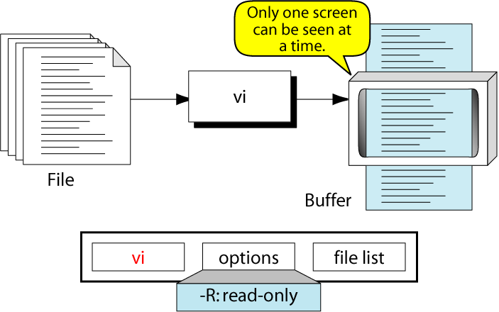

Slide 6
Command Mode
This is the mode where you can pass command to act on text, using most of the keys of the keyboard.
Commands used to move the cursor, to delete or change part of the test, etc.
As soon as the command is entered , it is executed – the Return key is not required.
Command are also known as hot key.
The command must be valid command otherwise give unpredictable result.

Slide 7
Starting vi Editor
To start using vi, at the Unix prompt type vi followed by a file name. If you wish to edit an existing file, type in its name; if you are creating a new file, type in the name you wish to give to the new file.
$ vi filename
Then hit Return. You will see a screen similar to the one below which shows blank lines with tildes and the name and status of the file.

Slide 8
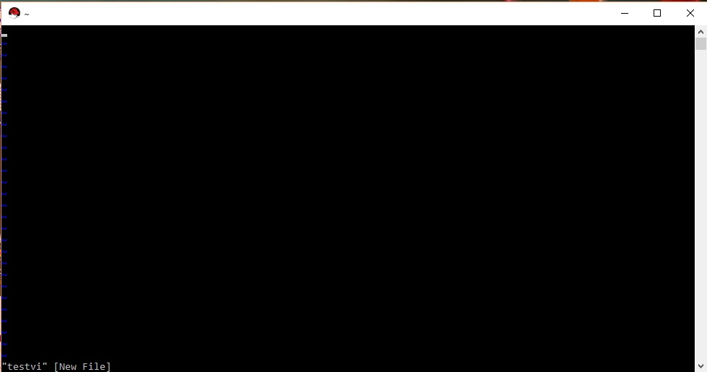

Slide 9
vi Editor
You will notice a tilde (~) on each line following the cursor.
A tilde represents an unused line.
If a line does not begin with a tilde and appears to be blank, there is a space, tab, newline, or some other nonviewable character present.
So now you have opened one file to start with.

Slide 10
vi Editor
The vi has two modes:
Command mode
Input mode (Insert mode)
Last Line mode

Slide 11
Command Mode
When you first start editing a file with the vi editor you will be in vi command mode.
In this mode you can issue many vi commands, including commands like insert, append, and delete, and other search and navigation commands that let you move around your file.
In this mode all key pressed by the user are interpreted to be editor commands.
In command mode, The key that are hit are not displayed on the screen.
In command mode, the letters of the keyboard perform editing functions (like moving the cursor, deleting text, etc.).
To enter command mode, press the escape <Esc> key.
When you're in command mode you can't insert text immediately. You first need to issue an insert, append, or open command to insert text.

Slide 12
Text (Input) Mode
To enter into this mode, first press “I”.(eye)
When the vi editor is in the text mode, any key that is pressed by a user is considered text.
This mode permit insertion of new text, edition of existing text or replacement of existing text.
The characters are inserted into the text at the cursor.
To add the text in a document, we should place the cursor at the desired location.
Each of these operation can be performed only after changing over from the command mode to Input or inserted mode.

Slide 13
Last Line (ex) Mode
This mode permits us to give command at the command line.
The bottom line of the vi screen is called command line or last line mode.
This mode used to handle files like saving file and perform substitution.
Pressing a “:” in the command mode invokes this mode.
We can then enter an ex mode command followed by “enter”.
After running command , we are back to the default command mode.

Slide 14
Changing Mode
We must switch back and forth between vi command and text modes.
To tell vi to do something, it must be in command mode, to edit text , we must be in text mode.
To invoke vi, you type : vi filename
The filename is the name of the file that already exists or the name of the file you want to create.
When you invoke vi, you are always in the command mode.
To exit vi you must be in command mode.
There are six commands that take you to the text mode (a, A, i, I, o, and O).
When you are in the text mode, you press the Escape key (esc) to go to the command mode.

Slide 15
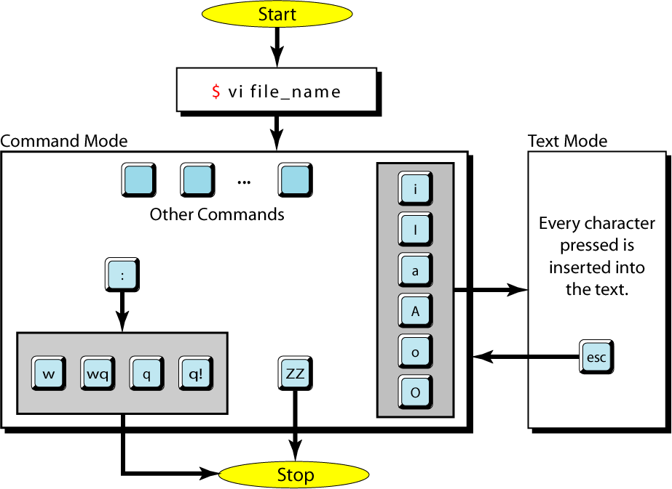
vi Modes

Slide 16
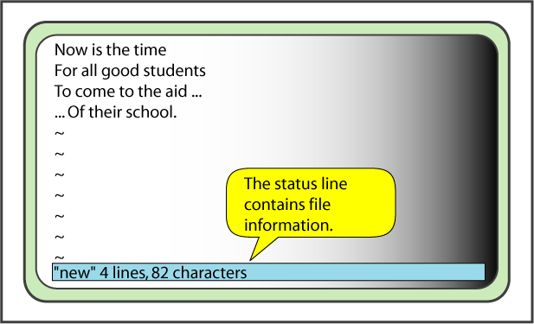
A Small File in vi

Slide 17
Command
To insert text, we have to in text or input mode.
Vi editor have several command to change the mode to text.
COMMAND | FUNCTION
i | Insert text before the current character.
I | Insert text at beginning of the current line.
a | Append text after the current character.
A | Append text at the end of the current line.
o | Open any empty text line for new text after the current line.
O | Open any empty text line for new text before the current line.

Slide 18
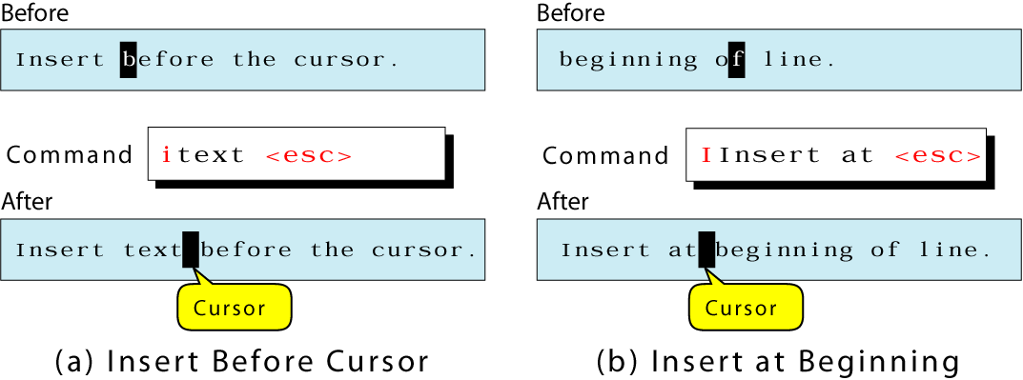
Insert Text Before The Cursor and Line
i inserts text before the current character
I inserts text at the beginning of the current line

Slide 19
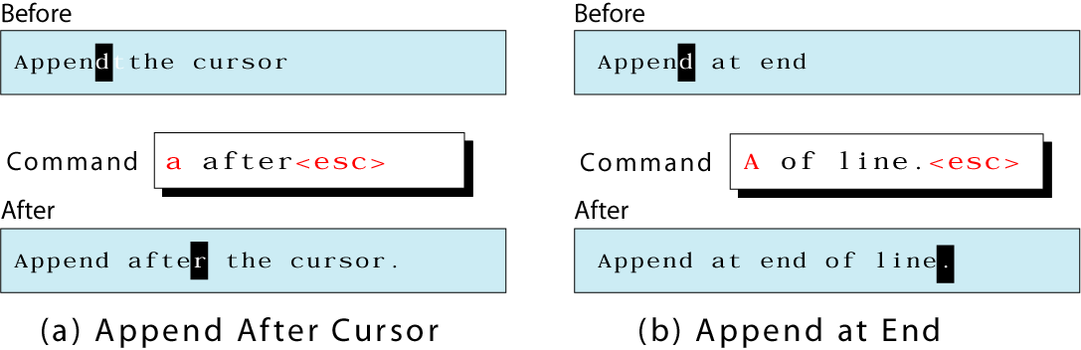
Insert Text After the Cursor and Line
a appends text after the current character.
A appends text at the end of the current line.

Slide 20
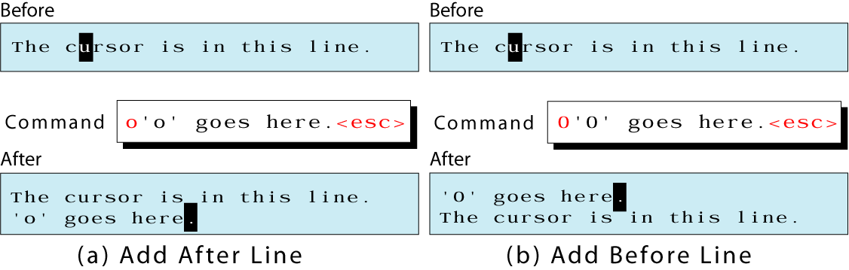
Insert New Line
o opens an empty text line for new text after the current line
O opens an empty text line for new text before the current line

Slide 21
Delete Command
COMMAND | FUNCTION
x | Delete the current character.
dd | Delete the current line.

Slide 22
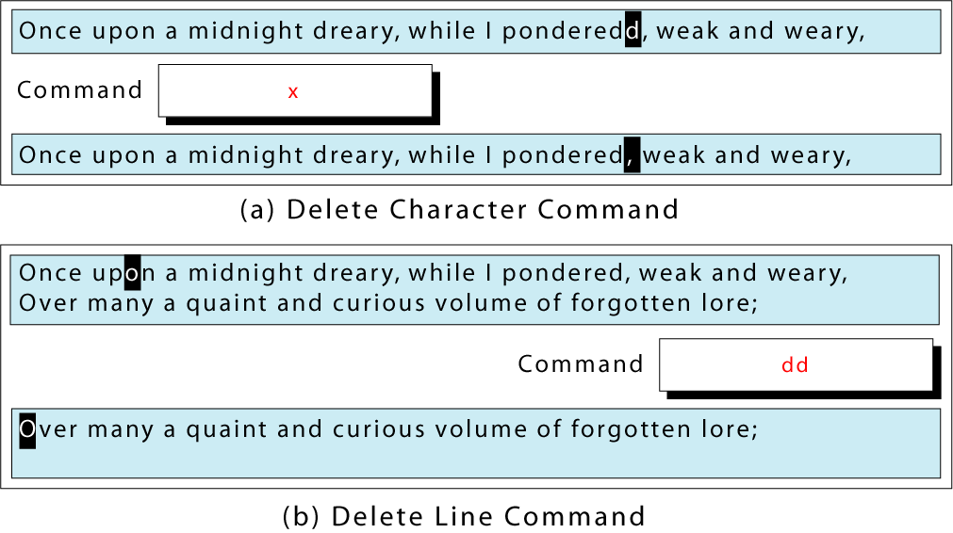
Delete Commands

Slide 23
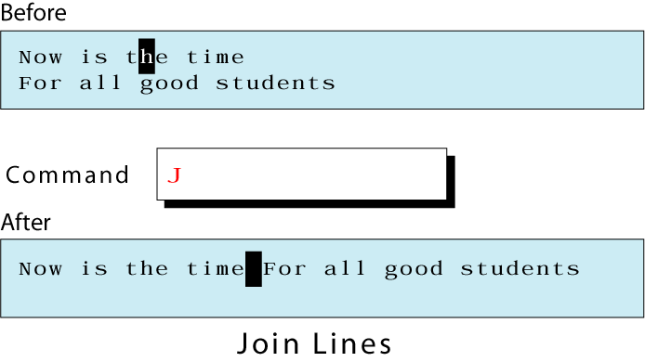
The join Command

Slide 24
Vim navigation options
Line navigation
Screen navigation
Word navigation
Special navigation
Paragraph navigation
Search navigation
Code navigation
Navigation from command line

Slide 25
Line navigation
Following are the four navigation that can be done line by line.
k – navigate upwards
j – navigate downwards
l – navigate right side
h – navigate left side
By using the repeat factor in VIM we can do this operation for N times.
For example: when you want to go down by 10 lines, then type “10j”.
.

Slide 26
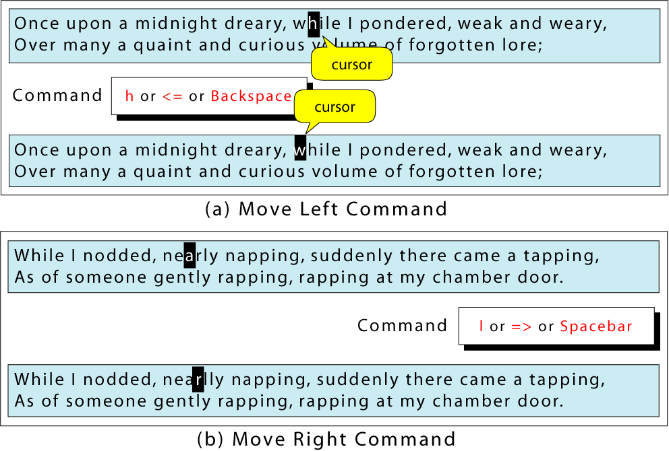
Horizontal Moves

Slide 27
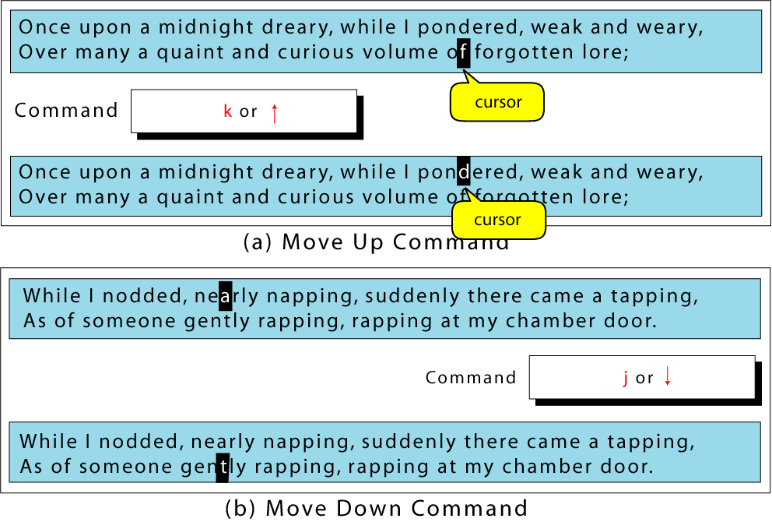
Vertical Moves

Slide 28
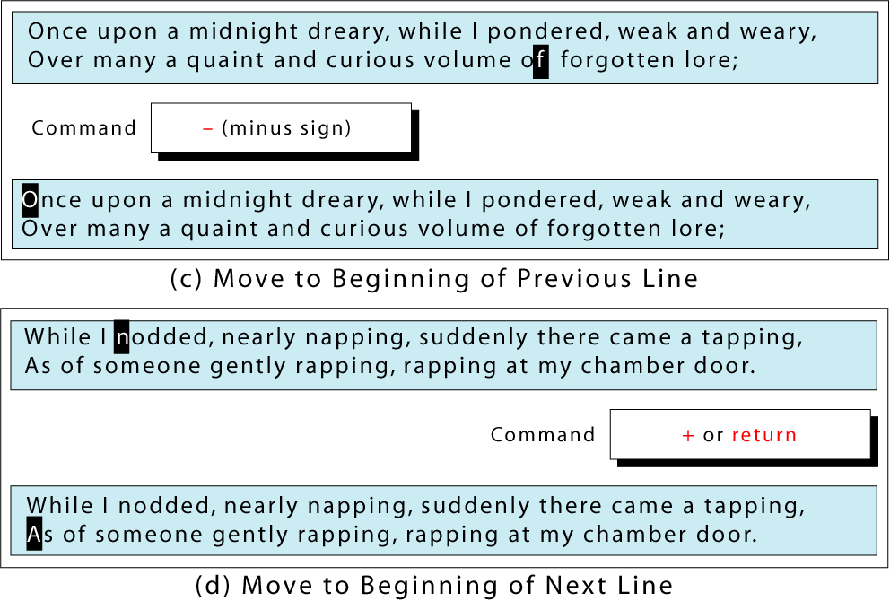
Vertical Moves

Slide 29
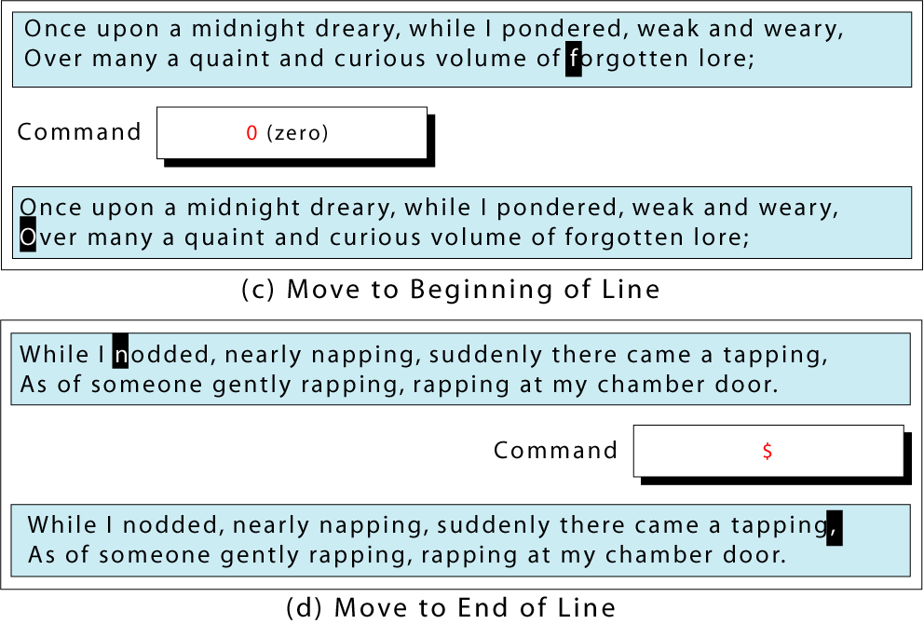
Horizontal Moves

Slide 30
Line navigation
Within a line if you want to navigate to different position, you have 4 other options.
0 – go to the starting of the current line.
^ – go to the first non blank character of the line.
$ – go to the end of the current line.
g_ – go to the last non blank character of the line

Slide 31
Screen navigation
Following are the three navigation which can be done in relation to text shown in the screen.
H – Go to the first line of current screen.
M – Go to the middle line of current screen.
L – Go to the last line of current screen.
ctrl+f – Jump forward one full screen.
ctrl+b – Jump backwards one full screen
ctrl+d – Jump forward (down) a half screen
ctrl+u – Jump back (up) one half screen

Slide 32
Special navigation
You may want to do some special navigation inside a file, which are:
N% – Go to the Nth percentage line of the file.
NG – Go to the Nth line of the file.
G – Go to the end of the file.
`” – Go to the position where you were in NORMAL MODE while last closing the file.
`^ – Go to the position where you were in INSERT MODE while last closing the file.
g – Go to the beginning of the file.

Slide 33
Word navigation
You may want to do some special navigation inside a file, which are:
e – go to the end of the current word.
b – go to the previous (before) word.
w – go to the next word.

Slide 34
Paragraph navigation
{ – Go to the beginning of the current paragraph.
By pressing { again and again move to the previous paragraph beginnings.
} – Go to the end of the current paragraph.
By pressing } again and again move to the next paragraph end, and again.

Slide 35
Search navigation
/i – Search for a pattern which will you take you to the next occurrence of it.
?i – Search for a pattern which will you take you to the previous occurrence of it.
* – Go to the next occurrence of the current word under the cursor.
# – Go to the previous occurrence of the current word under the cursor.

Slide 36
Command line navigation
Vim +N filename: Go to the Nth line of the file after opening it.
vim +10 /etc/passwd
Vim +/pattern filename: Go to the particular pattern’s line inside the file, first occurrence from first. In the following example, it will open the README file and jump to the first occurrence of the word “install”.
vim +/install README

Slide 37
Cursor Move Command
To edit text, we need to move the cursor to the text to be edited.
It is effective in only command code.
After execution of move command , vi editor is in command mode.

Slide 38
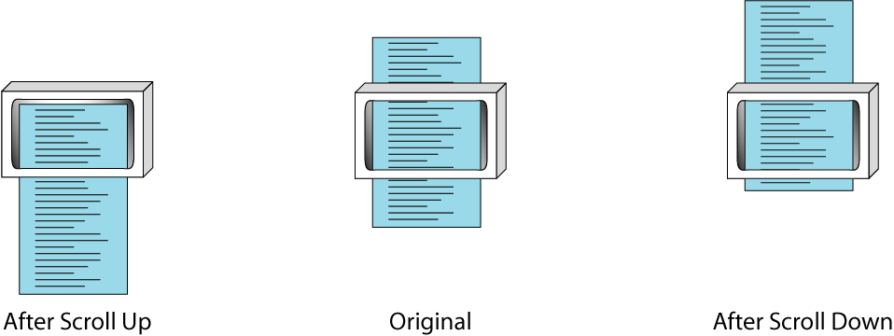
Scrolling
ctrl+b scrolls up the whole screen
ctrl+f scrolls down the whole screen

Slide 39
Scrolling (cont)
ctrl+u scrolls up half a screen
ctrl+d scrolls down half a screen
ctrl+y scrolls up one line
ctrl+e scrolls down one line

Slide 40
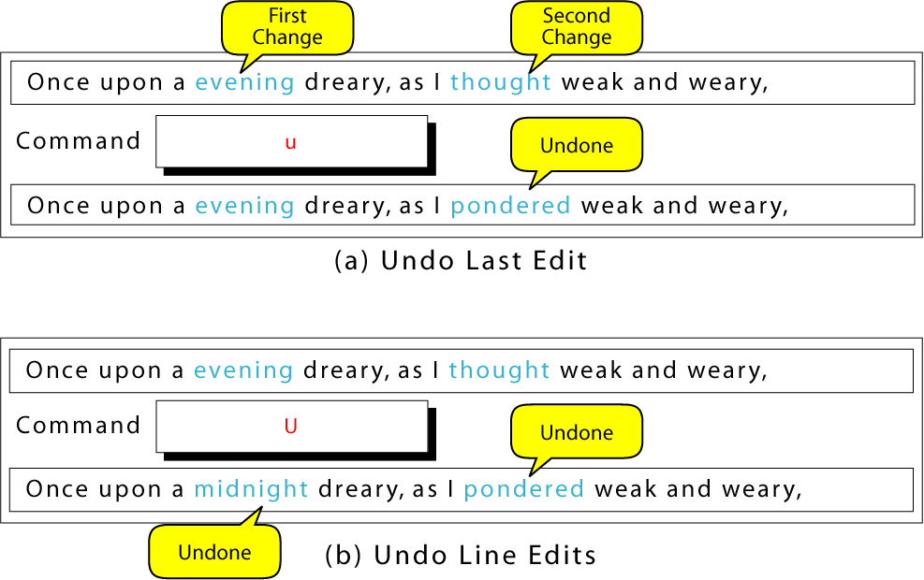
Undo Commands

Slide 41
Save & Exit Commands
COMMAND | MEANING
:w | Saves the contents of the buffer without quitting vi.
:w file | Writes contents of the buffer to new files and continues.
zz | Saves the content of the buffer and exits.
:wq | Saves the content of the buffer and exits.
:q | Exits the vi (if buffer changed will not exit)
:q! | Exits the vi without saving.

